Slide 1

Authentication Without Passwords
WeShape Tech Talks
16th Feb 2023

Slide 2


Password Security
Use complex password policies
Multi Factor Authentication
One-time Login codes
Trusted Devices
Biometric – facial / fingerprint
Password Managers

Slide 3

SSH Key Pair Authentication
Public and Private cryptographic keys
Key management
Rotating & Expiring Keys
OpenSSH Certificate Authentication

Slide 4

Automation & Build Pipelines
Password Stores
API Keys & Tokens
Trusted Profiles
Trusted Identity Provider

Slide 5

OpenID Connect with Cloud Services
Used to IAM systems authenticating users to apps.
Use same system for machine -> machine
CI / CD system runs OIDC service
Cloud provider trusts OIDC service
Pipeline jobs issued a JWT token
Cloud provider validates JWT and assumes roles to grant permissions

Slide 6
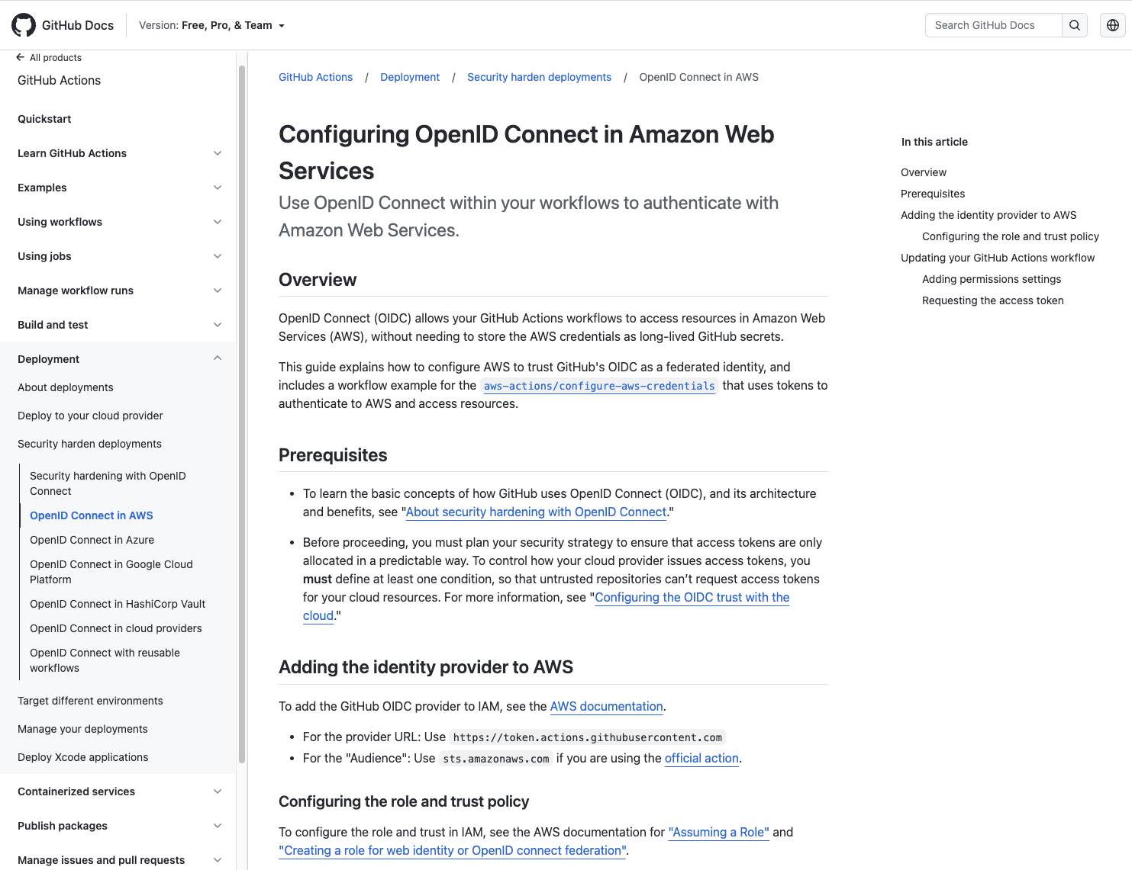
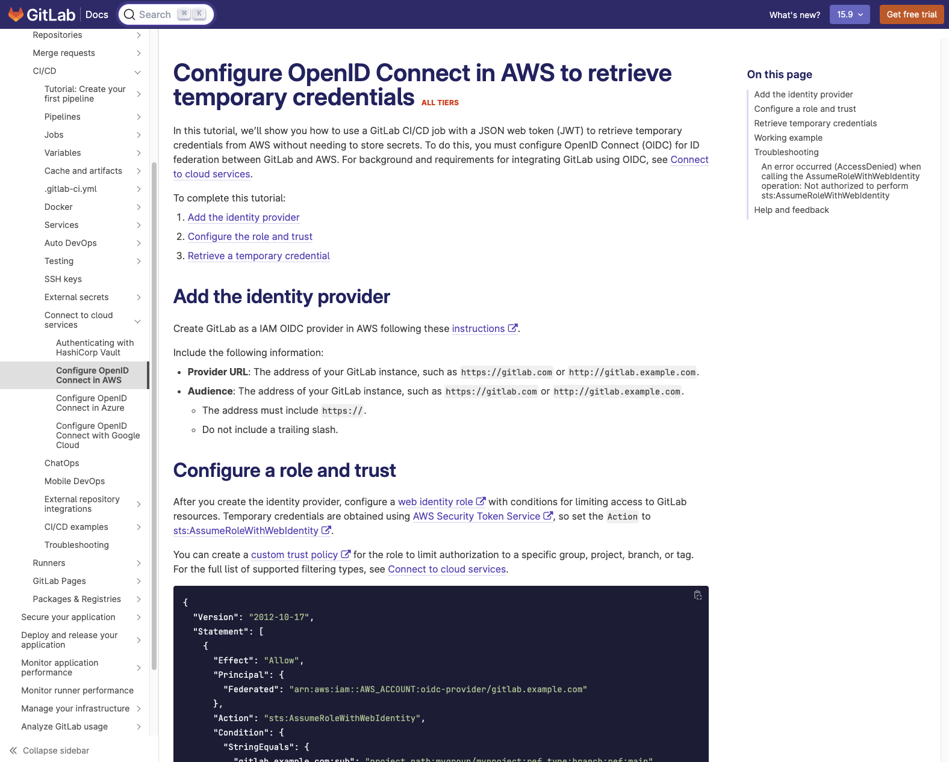
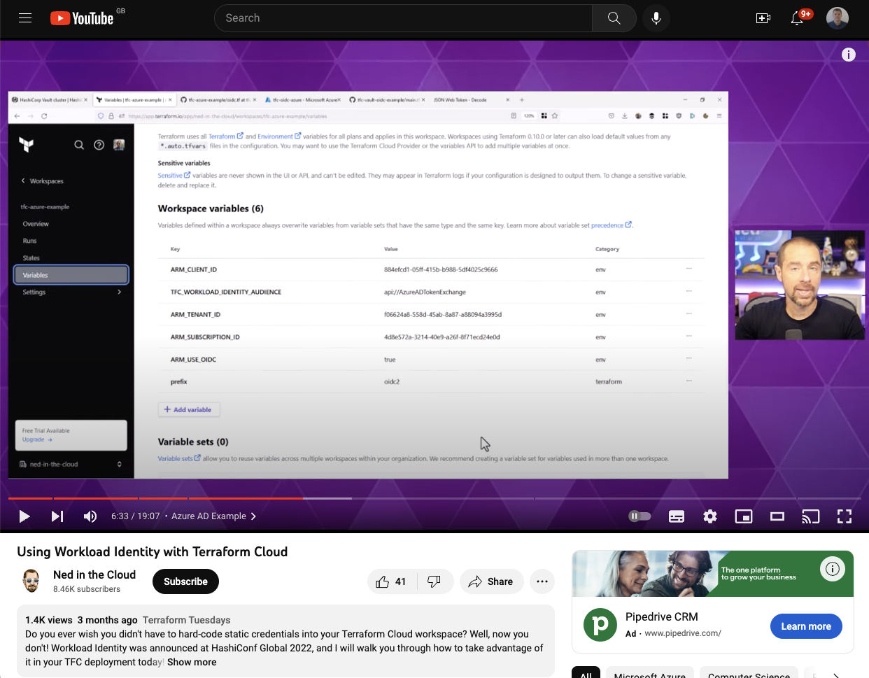

Slide 7
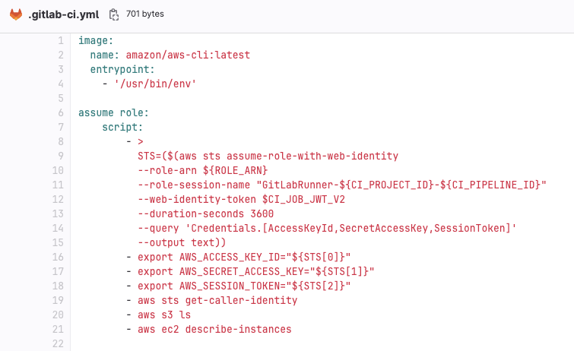
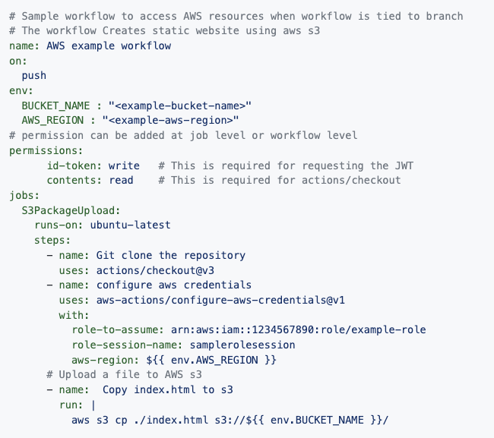
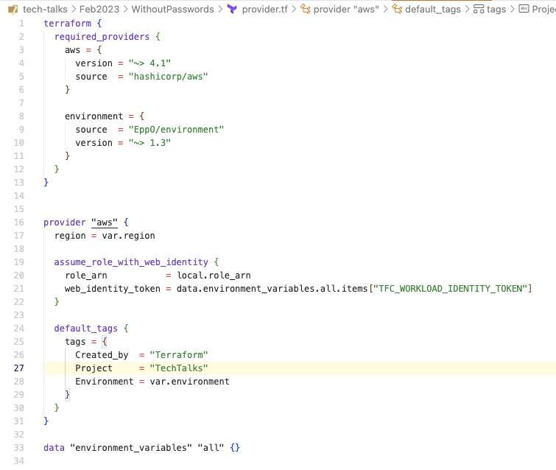

Slide 8









What about other services ?

Slide 9
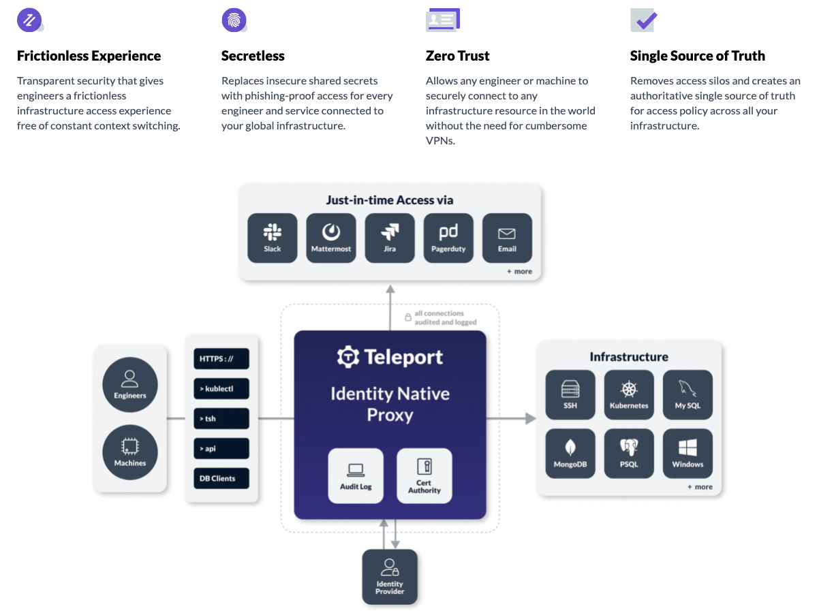

Teleport

Slide 10

Links
github.com/devops-consultants/tech-talks
goteleport.com/
docs.github.com/en/actions/deployment/security-hardening-your-deployments/about-security-hardening-with-openid-connect
docs.gitlab.com/ee/ci/cloud_services/aws/
https://youtu.be/M5hJwl2ewTk

